Slide 1
Foundations of Deep Learning
How Neural Networks Learn
Week 6 - Day 2

Slide 2
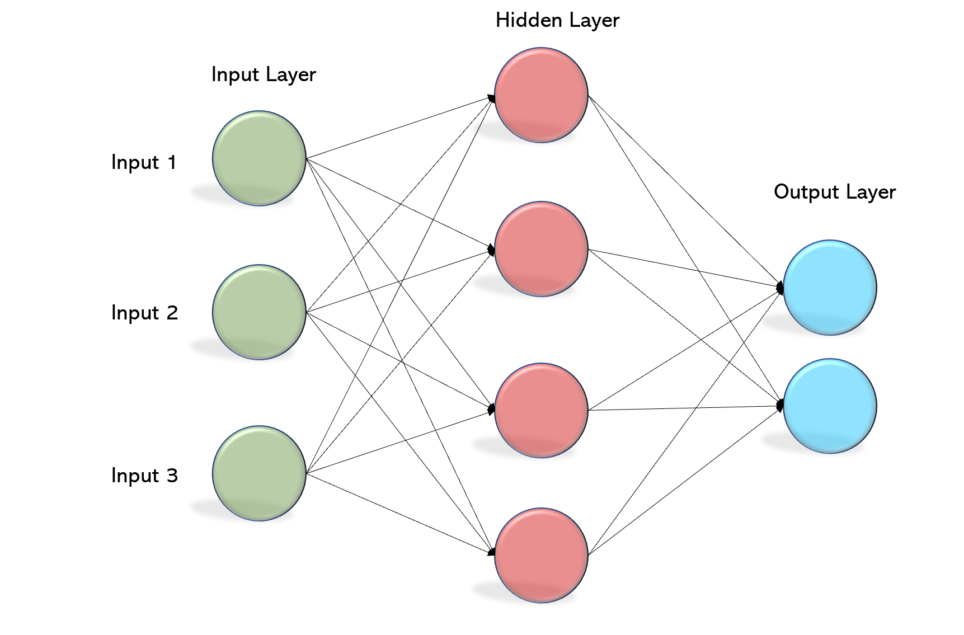
Recap: Multi-Layer Perceptron (MLP) Structure
Key Points:
Layers Overview:
Input Layer: Receives raw data/features.
Hidden Layers: Intermediate processing layers where non-linear transformations occur.
Output Layer: Produces the final prediction or decision.
Connections & Weights:
Each neuron in one layer connects to neurons in the next, with an associated weight.
Feedforward Operation:
Data flows from input to output.

Slide 3
What is an Activation Function?
Definition: An activation function introduces non-linearity into a network, allowing it to learn complex patterns.
Purpose: Without activation functions, a neural network would behave as a linear regression model regardless of the depth.
Key Concepts:
Non-Linearity:
Enables the model to capture intricate, non-linear relationships in the data.
Thresholding Behavior:
Some activation functions can “activate” (fire) only when a signal is above a certain threshold.

Slide 4
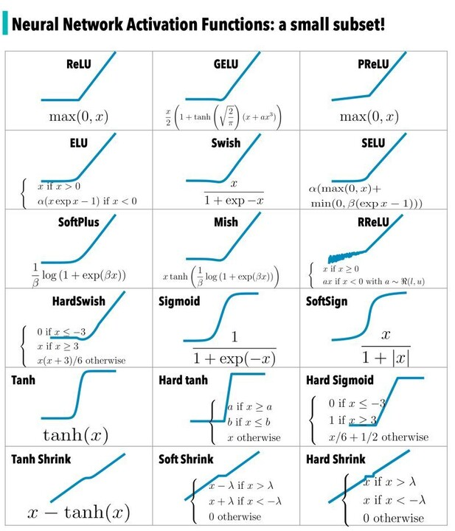
Types of Activation Functions
Sigmoid:
Range: 0 to 1
Characteristics: Smooth curve; useful for probability estimation (commonly used in the output layer for binary classification).
Drawbacks: Susceptible to vanishing gradients in deep networks.
Tanh (Hyperbolic Tangent):
Range: -1 to 1
Advantages: Zero-centered outputs, often leading to a faster convergence than sigmoid.
Drawbacks: Still prone to saturation and vanishing gradients for extreme values.
ReLU (Rectified Linear Unit):
Behavior: Outputs zero for negative inputs and a linear function for positive inputs.
Benefits:
Computationally efficient
Helps mitigate vanishing gradients in deep networks.
Potential Issue: Can lead to “dying ReLU” when neurons output zero too often.

Slide 5
ReLU vs. Sigmoid – Which to Use When?
When to Use ReLU:
You’re dealing with deep networks where vanishing gradients are a concern.
Faster convergence is desired.
Sparsity in activation is beneficial.
When to Use Sigmoid:
In the output layer for binary classification tasks (interpretable as probabilities).
In architectures where the output naturally lies within the 0–1 range.

Slide 6
What is a Loss Function?
Core Idea:
Definition:
A loss function measures the difference between the network’s predictions and the actual target values.
Purpose:
It provides a signal (error) to update weights during training.
Analogy:
Think of it as the “cost” or “penalty” for having inaccurate predictions.

Slide 7
Common Loss Functions: MSE & Cross-Entropy
Mean Squared Error (MSE):
Use: Primarily for regression tasks.
Formula: Average of squared differences between predictions and actual values.
Intuition: Penalizes larger errors more severely.
Cross-Entropy Loss:
Use: Widely used in classification tasks.
Function: Measures the dissimilarity between two probability distributions (the predicted probabilities vs. the true labels).
Intuition: High penalty for confident but wrong predictions.

Slide 8
What Loss Tells Us About a Model
Indicator of Performance:
A high loss indicates that predictions deviate significantly from true targets, while a low loss suggests better performance.
Training Process:
The goal is to iteratively adjust weights to minimize the loss, thereby improving model predictions.
Overfitting & Underfitting:
Too high loss on training data might indicate underfitting.
A low training loss but high validation loss can point to overfitting.

Slide 9
Backpropagation
Concept:
Backpropagation is the method through which neural networks learn by updating weights based on the error.
Simplified Process:
First, compute the error at the output.
Then “send” this error backward through the network.
Analogy:
Imagine a factory assembly line where each station (layer) adjusts its output based on feedback from the quality control (loss measurement).

Slide 10
Step-by-Step: How Backpropagation Works
Forward Pass:
Input data is passed through the network to generate an output.
Loss Computation:
The loss function measures how far the output is from the target.
Backward Pass (Error Propagation):
Use the chain rule to compute gradients – determine how each weight contributes to the error.
Weight Update:
Adjust weights using an optimization algorithm (e.g., gradient descent) to reduce error.

Slide 11
Gradient Descent: Finding the Minimum
Concept:
Gradient descent is an iterative optimization technique used to minimize the loss function.
Mechanism:
At each iteration, the algorithm moves the weight parameters in the direction opposite to the gradient (i.e., downhill on the loss surface).
Visualization:
Picture a ball rolling down a hill, gradually finding the lowest point.

Slide 12
Learning Rate and Optimization Strategies
Learning Rate:
Definition:
A hyperparameter that determines the size of the steps taken in gradient descent.
Trade-offs:
Too high: Risk overshooting the minimum.
Too low: Convergence can be very slow.
Optimization Algorithms:
Stochastic Gradient Descent (SGD):
Updates parameters using a subset (mini-batch) of training data.
Advanced Methods (e.g., Adam, RMSprop):
Incorporate momentum and adaptive learning rates to speed up and stabilize training.

Slide 13
Addressing Training Challenges: Vanishing/Exploding Gradients
Vanishing Gradients:
Problem:
Gradients become very small, causing minimal weight updates—commonly seen with saturating activations (like Sigmoid/Tanh) in deep networks.
Exploding Gradients:
Problem:
Gradients become extremely large, leading to unstable updates and potential divergence.
Mitigation Techniques:
Use activation functions like ReLU to help prevent vanishing gradients.
Implement gradient clipping and careful weight initialization.

Slide 14
Visual Walkthrough of a Forward and Backward Pass
Forward Pass:
Input features are multiplied by weights, biases are added, and activation functions are applied sequentially across layers.
Loss Calculation:
The network’s output is compared against the target values using a loss function.
Backward Pass:
The computed loss is propagated backward, layer by layer, calculating gradients for each weight.
Weight Update:
All weights are updated simultaneously using gradient descent or an alternative optimization method.

Slide 15
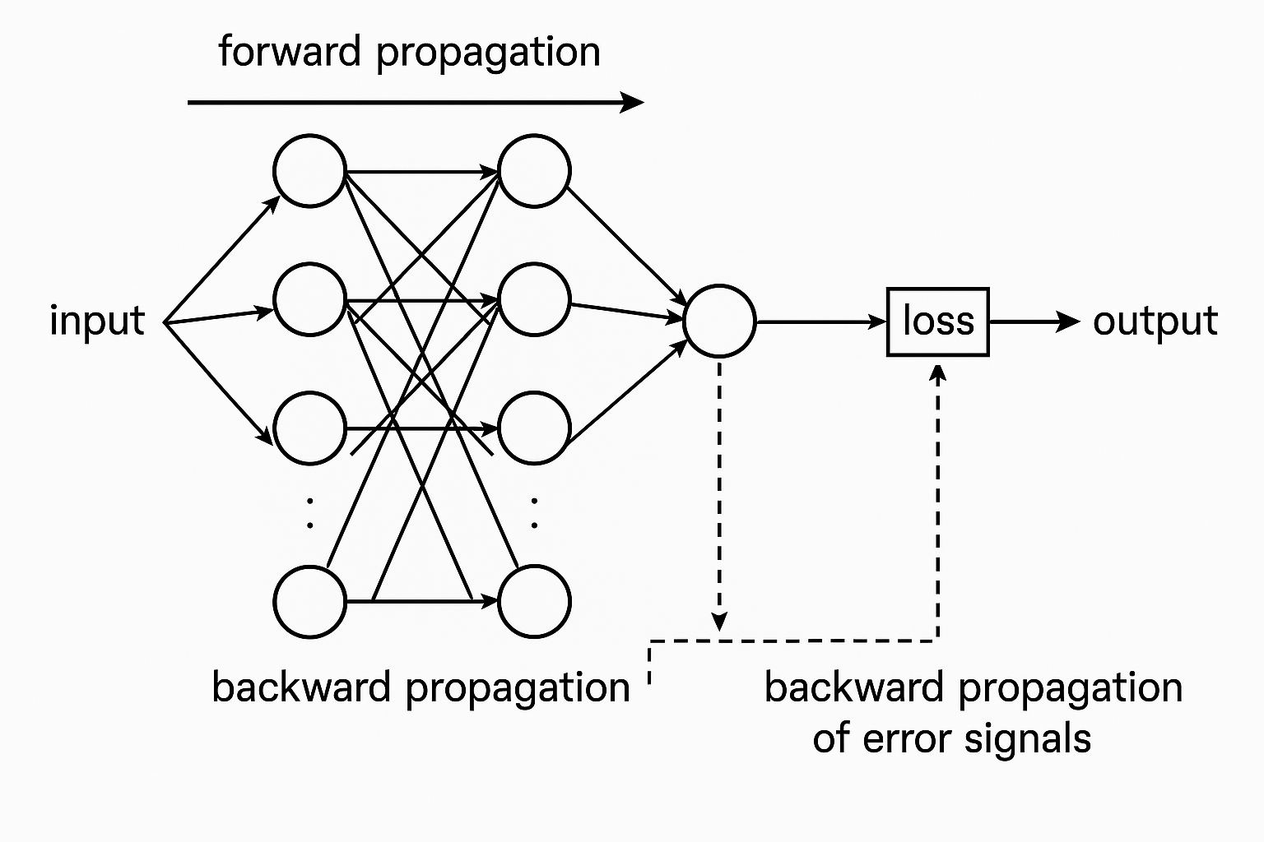

Slide 16
Mini Quiz Questions:
What purpose do activation functions serve in a neural network?
In what scenarios would you prefer ReLU over Sigmoid?
Explain the difference between Mean Squared Error and Cross-Entropy Loss.
How does backpropagation enable a network to “learn” from its mistakes?

